Slide 1
Theory of Computation
Lecture 10
CFG & PDA (Cont’d)
Dr. Samar Hesham
Department of Computer Science
Faculty of Computers and AI
Cairo University
Egypt

Slide 2
Syllabus and Terminologies
Regular Languages .. Regular Sets
REs (Regular Expressions)
FSMs (or FSA/FA) … Finite State Machines/Automata
DFSM/DFA vs. NDFSM/NFA … Deterministic vs. Non-deterministic FSM
Comparison and conversion
Examples & Closure Operations
Context Free Languages
CFGs … Context Free Grammars
PDA … Push Down Automata
Some applications
Turing Machine

Slide 3
The States
Input
symbol
Pop
symbol
Push
symbol

Slide 4
a^{n}b^{n}: with Stack Check
PDA :

Slide 5
Basic Idea:
Push the a’s
on the stack
2. Match the b’s on input
with a’s on stack
3. Match
found

Slide 6
Execution Example:
Time 0
Input
Stack
current
state

Slide 7
Time 1
Input
Stack

Slide 8
Time 2
Input
Stack

Slide 9
Time 3
Input
Stack

Slide 10
Time 4
Input
Stack

Slide 11
Time 5
Input
Stack

Slide 12
Time 6
Input
Stack

Slide 13
Time 7
Input
Stack

Slide 14
Time 8
Input
Stack
accept

Slide 15
Rejection Example:
Time 0
Input
Stack
current
state

Slide 16
Rejection Example:
Time 1
Input
Stack
current
state

Slide 17
Rejection Example:
Time 2
Input
Stack
current
state

Slide 18
Rejection Example:
Time 3
Input
Stack
current
state

Slide 19
Rejection Example:
Time 4
Input
Stack
current
state

Slide 20

Rejection Example:
Time 4
Input
Stack
reject
current
state

Slide 21
There is no accepting computation for
The string is rejected by the PDA

Slide 22
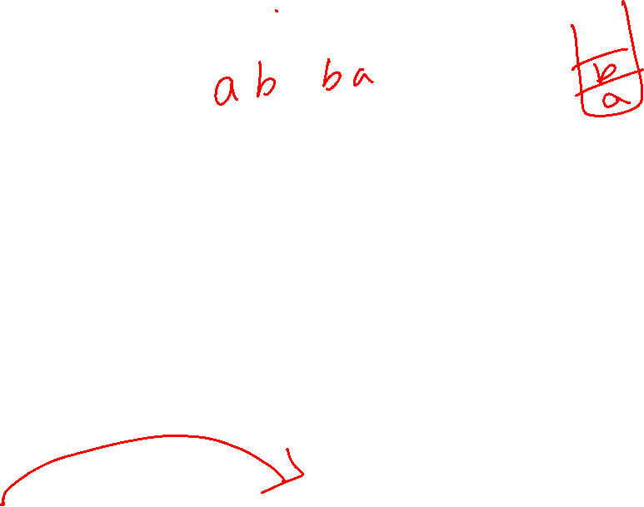
Palindromes with stack checking
PDA :

Slide 23
Basic Idea:
Push v
on stack
3. Match on input
with v on stack
2. Guess
middle
of input
4. Match
found

Slide 24
Execution Example:
Time 0
Input
Stack

Slide 25
Time 1
Input
Stack

Slide 26
Time 2
Input
Stack

Slide 27
Time 3
Input
Guess the middle
of string
Stack

Slide 28
Time 4
Input
Stack

Slide 29
Time 5
Input
Stack

Slide 30
Time 6
Input
Stack
accept

Slide 31
Rejection Example:
Time 0
Input
Stack

Slide 32
Time 1
Input
Stack

Slide 33
Time 2
Input
Stack

Slide 34
Time 3
Input
Guess the middle
of string
Stack

Slide 35

Time 4
Input
Stack

Slide 36
Time 5
Input
There is no possible transition.
Input is not consumed
Stack

Slide 37
Another computation on same string:
Input
Time 0
Stack

Slide 38
Time 1
Input
Stack

Slide 39
Time 2
Input
Stack

Slide 40
Time 3
Input
Stack

Slide 41
Time 4
Input
Stack

Slide 42

Time 5
Input
No accept state
is reached
Stack

Slide 43
There is no computation
that accepts string

Slide 44
Another PDA example
PDA

Slide 45
Execution Example:
Time 0
Input
Stack
current
state

Slide 46
Time 1
Input
Stack

Slide 47

Time 3
Input
Stack

Slide 48
Time 4
Input
Stack

Slide 49
Time 5
Input
Stack

Slide 50
Time 6
Input
Stack

Slide 51
Time 7
Input
Stack

Slide 52
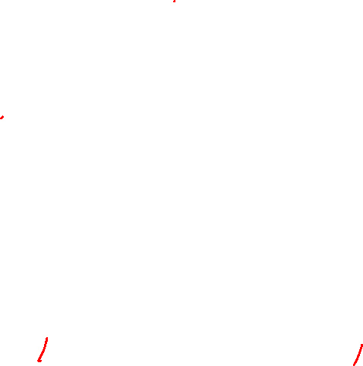
Time 8
Input
Stack
accept

Slide 53
Formal Definition
Pushdown Automaton (PDA)
Accept
states
States
Input
alphabet
Stack
start
symbol
Transition
function
Initial
state
Stack
alphabet

Slide 54
Types of PDA Transitions
Two types of PDA transitions:
δ(q, a, z) = {(p₁,γ₁), (p₂,γ₂),…, (p_{m},γ_{m})}
Current state is q
Current input symbol is a
Symbol currently on top of the stack z
Move to state p_{i} from q
Replace z with γ_{i} on the stack (leftmost symbol on top)
Move the input head to the next input symbol
:
p₁
a/z/ γ₁
q
a/z/ γ₂
p₂
a/z/ γ_{m}
p_{m}

Slide 55
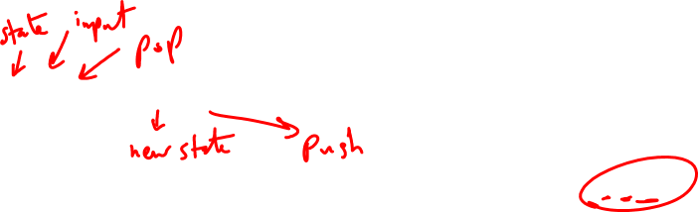
Types of PDA Transitions
Two types of PDA transitions:
δ(q, ε, z) = {(p₁,γ₁), (p₂,γ₂),…, (p_{m},γ_{m})}
Current state is q
Current input symbol is not considered
Symbol currently on top of the stack z
Move to state p_{i} from q
Replace z with γ_{i} on the stack (leftmost symbol on top)
No input symbol is read
:
p₁
ε/z/ γ₁
q
ε/z/ γ₂
p₂
ε/z/ γ_{m}
p_{m}

Slide 56
Transition function:

Slide 57
Transition function:

Slide 58
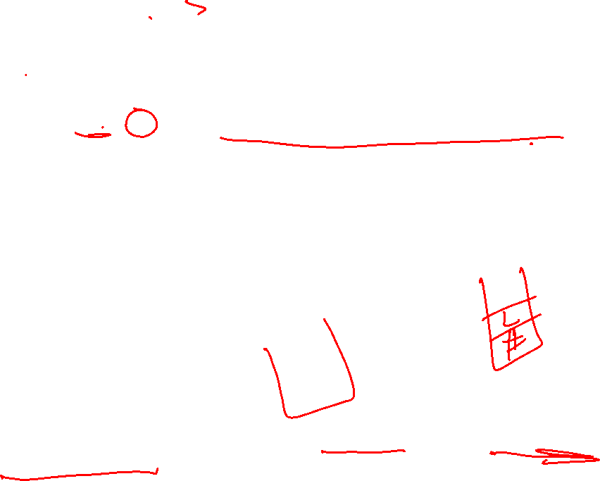
Example: 0^{n}1^{n}, n>=0
M = ({q₁, q₂}, {0, 1}, {L, #}, δ, q₁, #, Ø)
δ:
(1) δ(q₁, 0, #) = {(q₁, L#)} // stack order: L on top, then # below
(2) δ(q₁, 1, #) = Ø // illegal, string rejected, When will it happen?
(3) δ(q₁, 0, L) = {(q₁, LL)}
(4) δ(q₁, 1, L) = {(q₂, ε)}
(5) δ(q₂, 1, L) = {(q₂, ε)}
(6) δ(q₂, ε, #) = {(q₂, ε)} // if ε read & stack hits bottom, accept
(7) δ(q₂, ε, L) = Ø // illegal, string rejected
(8) δ(q₁, ε, #) = {(q₂, ε)} // n=0, accept
Goal: (acceptance)
Read the entire input string
Terminate with an empty stack
Informally, a string is accepted if there exists a computation that uses up all the input and leaves the stack empty.

Slide 59
0011
• (q1, 0 011, #) |-
(q1, 0 11, L#) |-
(q1, 1 1, LL#) |-
(q2, 1, L#) |-
(q2, e, #) |-
(q2, e, e): accept
• 011
• (q1, 0 11, #) |-
(q1, 1 1, L#) |-
(q2, 1, #) |-
Ø : reject

Slide 60
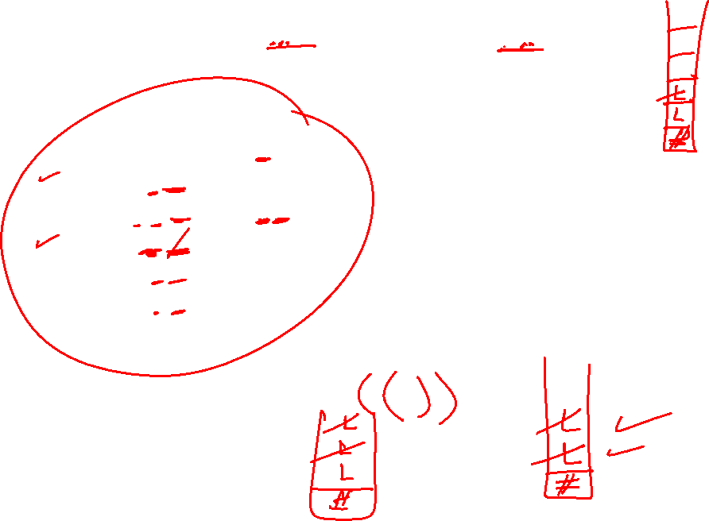
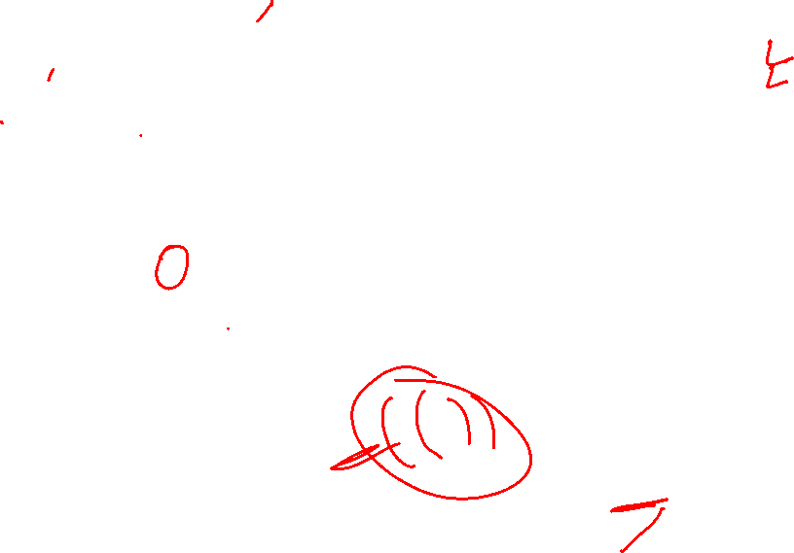
Example: balanced parentheses,
e.g. in-language: ((())()), or (())(), but not-in-language: ((())
M = ({q₁}, {“(“, “)”}, {L, #}, δ, q₁, #, Ø)
δ:
(1) δ(q₁, (, #) = {(q₁, L#)} // stack order: L-on top-then- # lower
(2) δ(q₁, ), #) = Ø // illegal, string rejected
(3) δ(q₁, (, L) = {(q₁, LL)}
(4) δ(q₁, ), L) = {(q₁, ε)}
(5) δ(q₁, ε, #) = {(q₁, ε)} // if ε read & stack hits bottom, accept
(6) δ(q₁, ε, L) = Ø // illegal, string rejected
// What does it mean? When will it happen?
Goal: (acceptance)
Read the entire input string
Terminate with an empty stack

Slide 61
Example PDA #2: For the language {x | x = ww^{r} and w in {0,1}*}
Note: length |x| is even
M = ({q₁, q₂}, {0, 1}, {#, B, G}, δ, q₁, #, Ø)
δ:
(1) δ(q₁, 0, #) = {(q₁, B#)}
(2) δ(q₁, 1, #) = {(q₁, G#)}
(3) δ(q₁, 0, B) = {(q₁, BB), (q₂, ε)} (6) δ(q₁, 1, G) = {(q₁, GG), (q₂, ε)}
(4) δ(q₁, 0, G) = {(q₁, BG)} (7) δ(q₂, 0, B) = {(q₂, ε)}
(5) δ(q₁, 1, B) = {(q₁, GB)} (8) δ(q₂, 1, G) = {(q₂, ε)}
(9) δ(q₁, ε, #) = {(q₂, #)}
(10) δ(q₂, ε, #) = {(q₂, ε)}
Notes:
Rules #3 and #6 are non-deterministic: two options each
Rules #9 and #10 are used to pop the final stack symbol off at the end of a computation.

Slide 62
Example Computation:
(1) δ(q₁, 0, #) = {(q₁, B#)} (6) δ(q₁, 1, G) = {(q₁, GG), (q₂, ε)}
(2) δ(q₁, 1, #) = {(q₁, G#)} (7) δ(q₂, 0, B) = {(q₂, ε)}
(3) δ(q₁, 0, B) = {(q₁, BB), (q₂, ε)} (8) δ(q₂, 1, G) = {(q₂, ε)}
(4) δ(q₁, 0, G) = {(q₁, BG)} (9) δ(q₁, ε, #) = {(q₂, ε)}
(5) δ(q₁, 1, B) = {(q₁, GB)} (10) δ(q₂, ε, #) = {(q₂, ε)}
State Input Stack Rule Applied Rules Applicable
q₁ 000000 # (1), (9)
q₁ 00000 B# (1) (3), both options
q₁ 0000 BB# (3) option #1 (3), both options
q₁ 000 BBB# (3) option #1 (3), both options
q₂ 00 BB# (3) option #2 (7)
q₂ 0 B# (7) (7)
q₂ ε # (7) (10)
q₂ ε ε (10)
Notes:
What is rule #10 used for – emptying the stack.
What is rule #9 used for – emptying the stack.
Why do rules #3 and #6 have options – you don’t know where the middle of the string is.
Why don’t rules #4 and #5 have similar options – suppose rule #4 had option (q₂, λ). Then 0100 would be accepted.

Slide 63
Instantaneous Description
Current
state
Current
stack
contents
Remaining
input
At any time t_{i}

Slide 64
Example:
Instantaneous Description
Time 4:
Input
Stack

Slide 65
Example:
Instantaneous Description
Time 5:
Input
Stack

Slide 66
We write:
Time 4
Time 5

Slide 67
A computation:

Slide 68
For convenience we write:

Slide 69
Language of PDA
Language accepted by PDA :
Initial state
Accept state

Slide 70
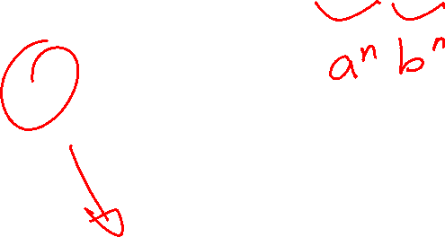
Example:
PDA :

Slide 71
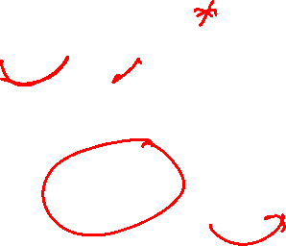
PDA :

Slide 72
Therefore:
PDA :

Slide 73

PDA versus CFLs
A language L is context-free if and only if there is a pushdown automata M that recognizes L.
Two step proof:
Given a CFG G, construct a PDA M_{G}
2) Given a PDA M, make a CFG G_{M}

Slide 74
Theorem:
Context-Free
Languages
(Grammars)
Languages
Accepted by
PDAs

Slide 75
Proof - Step 1:
Context-Free
Languages
(Grammars)
Languages
Accepted by
PDAs
Convert any context-free grammar
to a PDA with:

Slide 76
Proof - Step 2:
Context-Free
Languages
(Grammars)
Languages
Accepted by
PDAs
Convert any PDA to a context-free
grammar with:

Slide 77
Convert Context-Free Grammars to PDAs
Proof - step 1

Slide 78
Take an arbitrary context-free grammar
We will convert to a PDA such that:

Slide 79
Conversion Procedure:
For each
For each
production in
terminal in
Add transitions

Slide 80
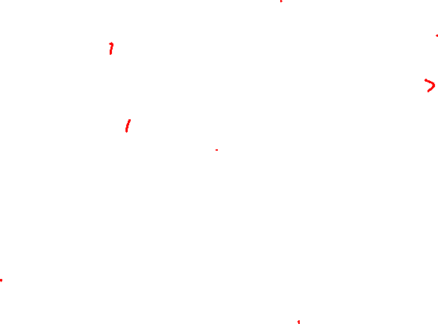
Example
Grammar
PDA

Slide 81
Sample Run:
Input
Time 0
Stack

Slide 82
Derivation:
Input
Time 1
Stack

Slide 83
Derivation:
Input
Time 2
Stack

Slide 84
Derivation:
Input
Time 3
Stack

Slide 85
Derivation:
Input
Time 4
Stack

Slide 86
Derivation:
Input
Time 5
Stack

Slide 87
Derivation:
Input
Time 6
Stack

Slide 88
Derivation:
Input
Time 7
Stack

Slide 89
Derivation:
Input
Time 8
Stack

Slide 90
Derivation:
Input
Time 9
Stack

Slide 91
Derivation:
Input
Time 10
Stack
accept

Slide 92
PDA simulates leftmost derivations
Grammar
Leftmost Derivation
PDA Computation
Scanned
symbols
Stack
contents

Slide 93
Grammar
Leftmost Derivation
PDA Computation

